Slide 1

For New Immigrants
Feasibility Report
Students of Computer Programming

Slide 2
Aim
GOAL 1
Design and develop a user-friendly platform
GOAL 2
Centralized hub information and appointments
GOAL 3
Facilitate a smoother transition into Canadian society for new immigrants

Slide 3






Challenges Faced by New Immigrants
Job hunting
Language acquisition
Accessing social services
And so on ..
Vast amounts of text

Slide 4
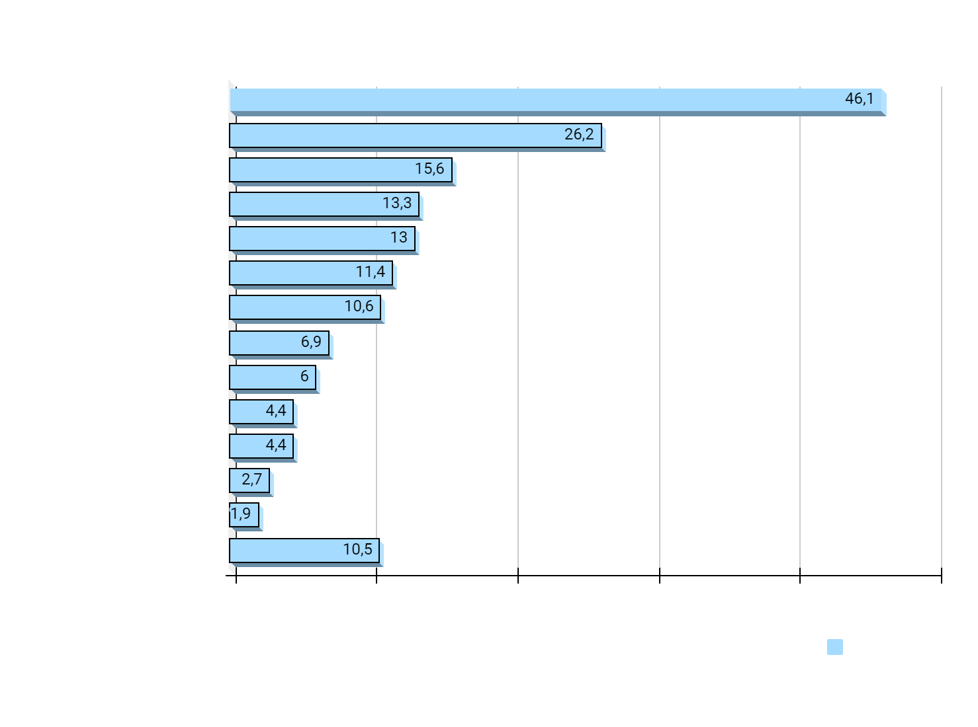
Greatest difficulties new immigrants faced since arriving in Canada
(Cited 4 years after arrival*)

Slide 5
Key Features
01.
Gamification and interactive elements
02.
Mobile Compatibility
03.
Secure and private handling
04.
Email notifications
05.
Multilingual support

Slide 6



Project Scope
Research, data collection, design, development and delivery
Evaluation of market demand, potential, and technical feasibility
Operational requirements assessment

Slide 7

Concept
Theory behind design
Game-design
Game principles
Non-game contexts

Slide 8

Complete tasks
Benefits Compared to Current Method
Manageable & enjoyable

Slide 9
Gamification
Government websites
Wordy, overwhelming, difficult to follow
Immersive experience
Entertaining & memorable
Achievement & motivator
Customized characters & badges
Interactive game
Breaking down complex tasks

Slide 10


About the website
Product
a combination of gamification and interactive features to guide new immigrants

Slide 11
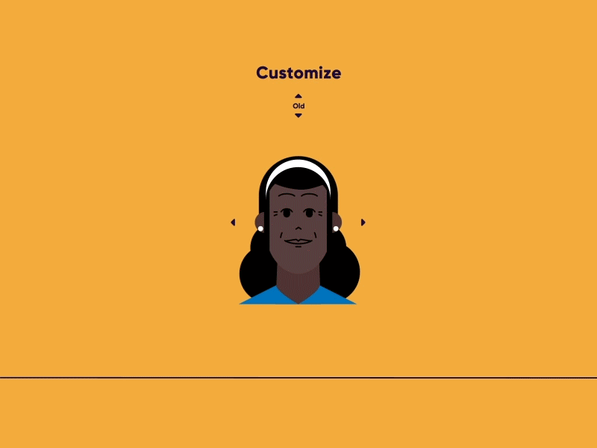

Example of Character Building
Skin color
Hair style
And other physical attributes

Slide 12
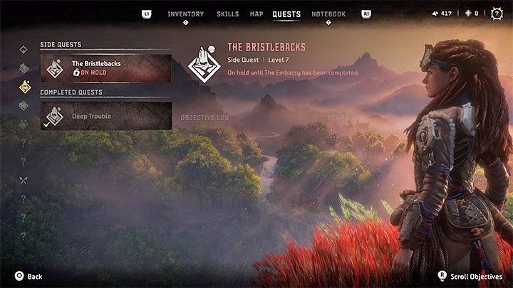

Example of a Quest
New player guidance
Challenge users to complete
Visual remaining of: eligibility criteria, required documents, and application processes

Slide 13
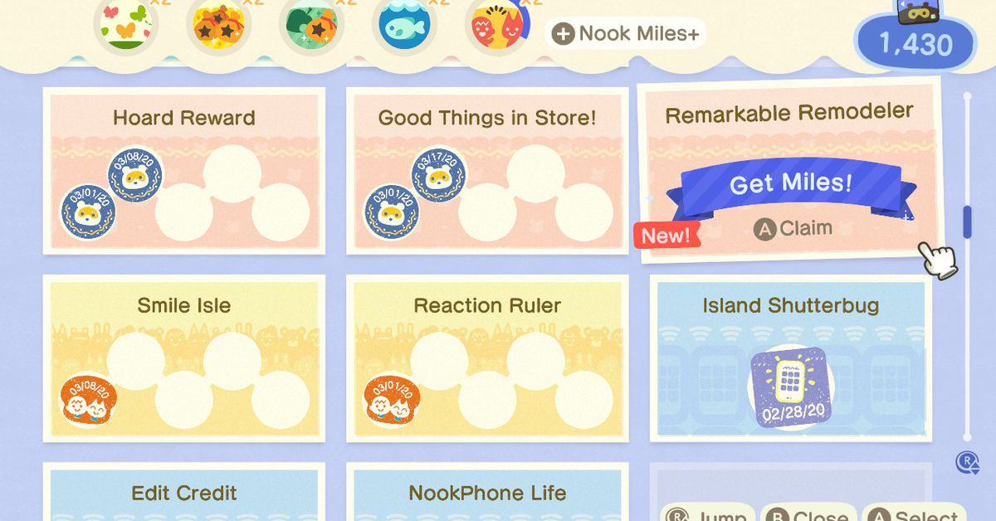




Award a badge
Achievement & fulfillment

Slide 14
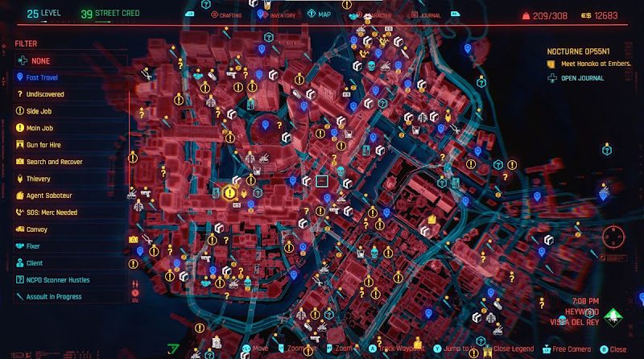

Open-world exploration

Slide 15


FAQ Section
QUICK ACCESS

Slide 16
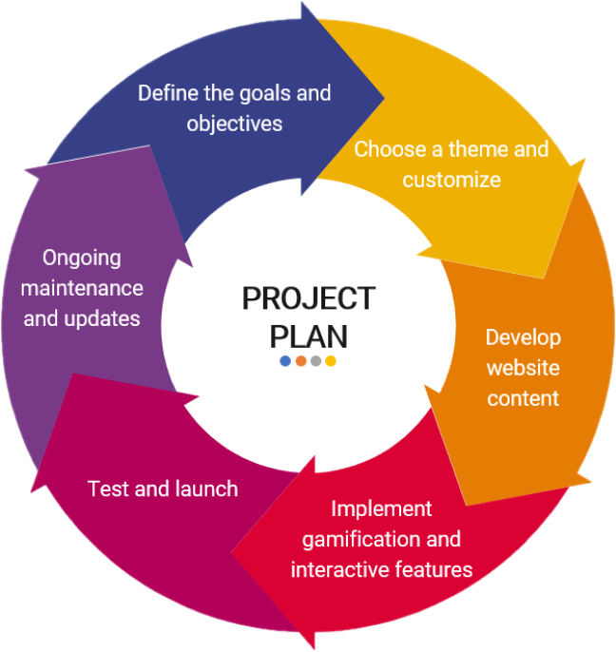

IMPLEMANTATION
Project Plan

Slide 17
Financial Implication
Cost Component | Estimated Cost Range
Design & Functionality | $5,000 - $8,000
Website hosting | $120 - $300 per year
Domain name | $20 per year
SSL Certificate | $30 - $80 per year
Maintenance Update | $1,000 - $1,500 per year
COST
BUDGET

Slide 18

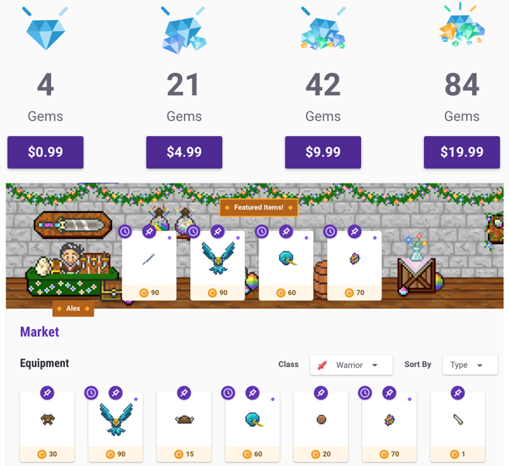
Financial Implication
Advertisements
Revenue
In-app purchases
Sponsorships
A freemium model

Slide 19

CONCLUSION
WHY CHOOSE US?
USER-FRIENDLY PLATFORM
INTERACTIVE AND ENGAGING
MULTILINGUAL SUPPORT
CONVINIENT

Slide 20
THANK YOU!
Do you have any questions?

Slide 21
OUR TEAM
KAITHLIN MANALO
XIA XI
ENL2019T SECTION 307
ENL20192T SECTION 308
WANQING TONG
FEI LAN
QIAOQING WU

